Slide 1
18-349: Introduction to Embedded Real-Time Systems
Lecture 16: Embedded Multicore
Anthony Rowe
Electrical and Computer Engineering
Carnegie Mellon University

Slide 2
Administrivia
Lab 3 rolling along
Checkpoint 2 (Friday Nov 4th)
Please do Mid-Class Survey
https://goo.gl/forms/aRrhbZfKFlFYtP2f2

Slide 3
Overview
Why multi-core embedded?
Example Architectures
Multiprocessor Scheduling
Dhall’s Effect
Global Scheduling
Partitioned Scheduling
Bin Packing

Slide 4
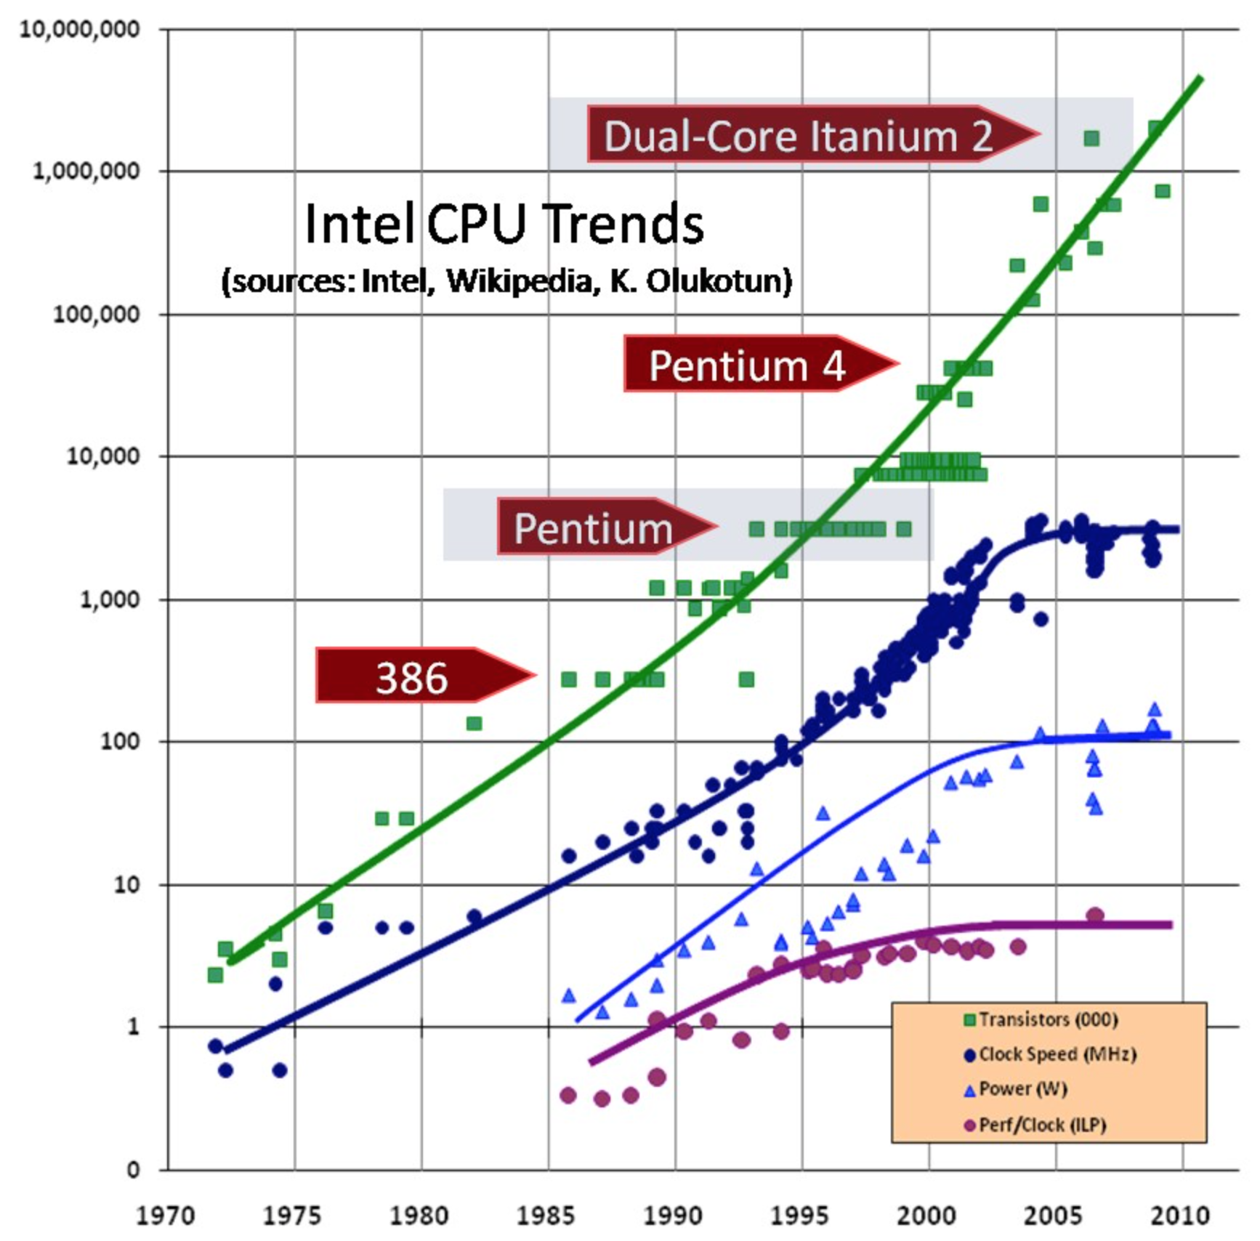
Hitting the “Power Wall”
Transistors (000)
Clock Speed (MHz)
Power (W)
Perf / Clock (ILP)

Slide 5

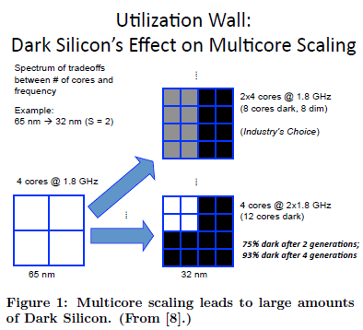
The end of multi-core scaling?
At 8nm it is estimated that more then 50% of transistors must remain dormant at any one time to avoid thermal runaway.

Slide 6
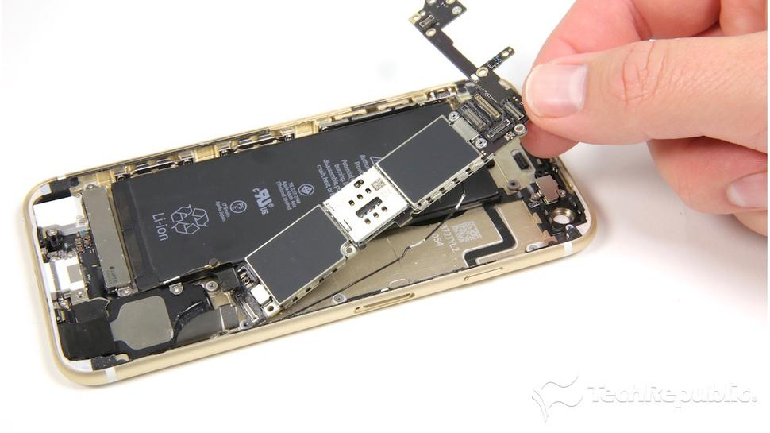
Embedded Trickle Down
Automotive Manufactures store 10 years worth of processors
Embedded Processors eventually adopted more advanced process technologies and architectures
Rise of ARM…
Application specific enhancements
Largely driven by performance / power

Slide 7
Multicore / SoC
Symmetric Multiprocessing (SMP)
Two identical cores
Common in servers / laptops
Asymmetric Multicore Processors (AMP)
Usually CPU + DSP
Often a mix of CPU types
System-on-a-Chip (SoC)
Mix of cores and custom hardware
Integrated FPGA

Slide 8
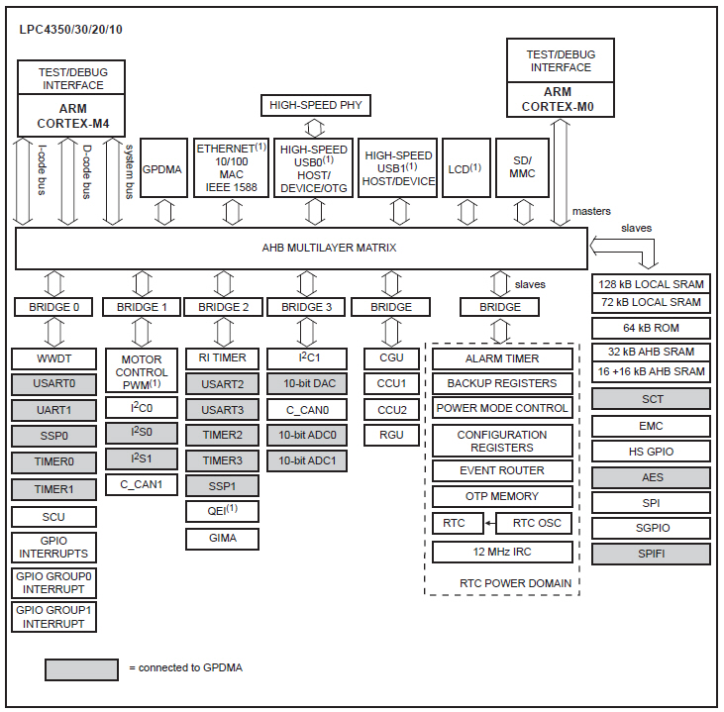
LPC4350
Low-Power AMP Processor from NXP

Slide 9
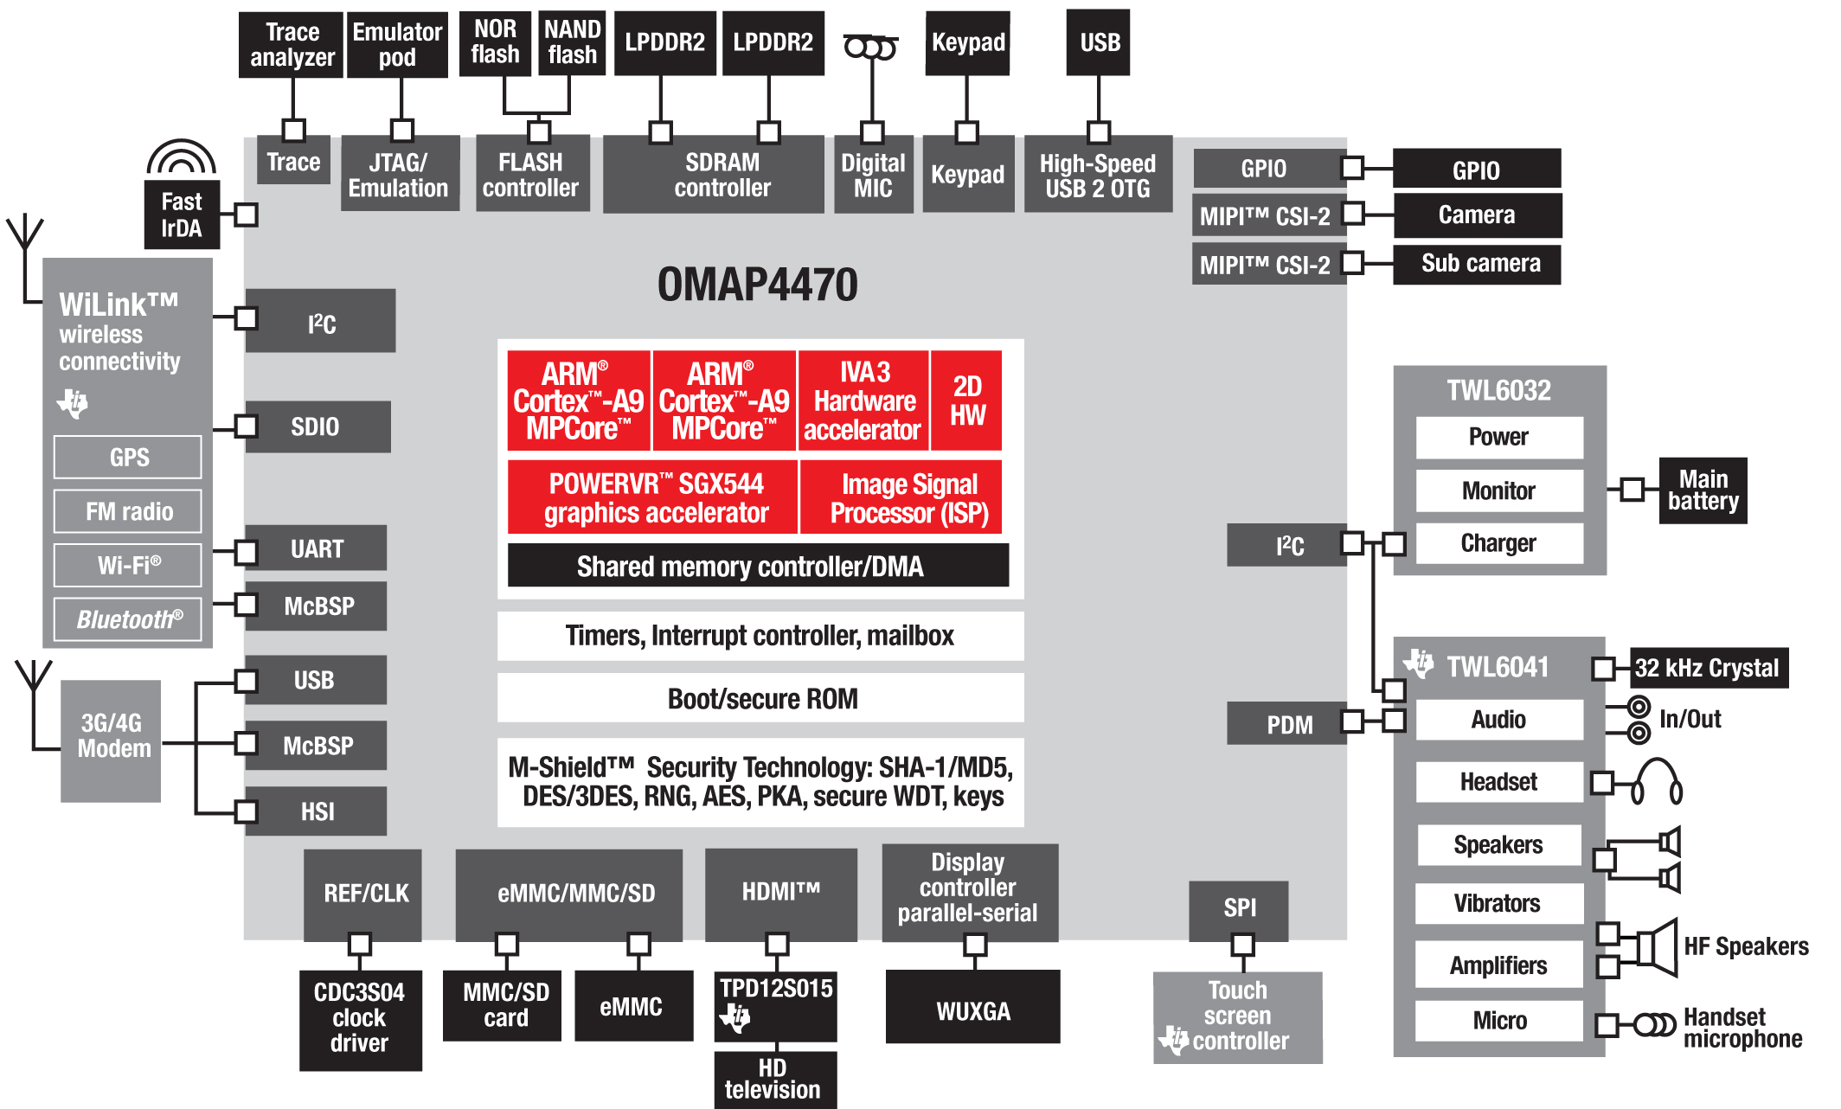
SoC with Symmetric Cores

Slide 10
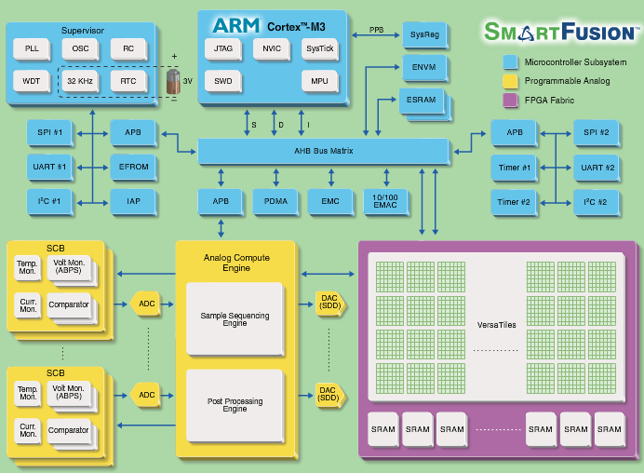
Actel Smart Fusion

Slide 11
Multicore Embedded Challenges
Toolchains are still primitive
SMP is relatively easy (just fork)
AMP is complex since you need to handle multiple targets
Complex peripheral management
Need to sleep peripherals to save power
Lots of tricks in how to utilize hardware
Lots of different I/O with driver dependencies
How do we reason about real-time constraints?

Slide 12
How do we reason about Real-Time Scheduling in these systems?

Slide 13
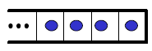
Global Scheduling for Multiprocessors
Single Shared Ready Queue
Processor₁
Processor₂
Processor₃
…
Processor_{m}

Slide 14
Partitioned Scheduling for Multiprocessors
One Ready Queue Per Processor
Processor₁
Processor₂
Processor₃
…
Processor_{m}

Slide 15
Global Multiprocessor Scheduling Characteristics
All ready tasks are kept in a common (global) queue
When selected for execution, a task can be dispatched to an arbitrary processor, even after being preempted
Task execution is assumed to be “greedy”:
If higher-priority tasks occupy all processors, a lower-priority task cannot execute until the execution of a higher-priority task is complete.

Slide 16
Global Scheduling
Advantages:
Supported by most multiprocessor operating systems
Windows NT, Solaris, Linux, ...
Effective utilization of processing resources
Unused processor time can easily be reclaimed
Disadvantages:
Weak theoretical framework
Few results from the uni-processor case can be used
Poor resource utilization for hard timing constraints
No more than 50% resource utilization can be guaranteed
Suffers from several scheduling anomalies
Sensitive to period adjustments

Slide 17
Global Scheduling
Complexity of schedulability analysis for global scheduling: (Leung & Whitehead, 1982)
The problem of deciding if a task set is schedulable on m processors with respect to global scheduling is NP-complete in the strong sense.
Consequence:
There can only exist a pseudo-polynomial time algorithm for
(i) finding an optimal static priority assignment, or
(ii) feasibility testing
But not both at the same time (unless P = NP)!

Slide 18
Weak Theoretical Framework
Underlying causes:
Dhall’s effect:
With RM, DM and EDF, some low-utilization task sets can be unschedulable regardless of how many processors are used.
Dependence on Relative Priority Ordering:
Changing the relative priority ordering among higher-priority tasks may affect the schedulability for a lower-priority task.
Uncharacterized Critical Instant:
A critical instant does not always occur when a task arrives at the same time as all its higher-priority tasks.

Slide 19
Dhall Effect (Dhall & Liu, 1978)
τ₁: (C₁ = 2ε, T₁ = 1); τ₂: (C₂ = 2ε, T₂ = 1); …; τ_{m:} (C_{m} = 2ε, T_{m} = 1)
τ_{m+1}: (C_{m+1} = 1, T_{m} = 1+ε)
2ε
2ε
1−2ε
Core 1
2ε
2ε
t_{m+1} misses its deadline
Core 2
…
2ε
2ε
Core m
0
1
τ₁
U_{total} = m(2ε) + 1/1+e
As ε → 0, U_{total} → 1
That is, only 1/m cycles in the system are being utilized, but deadlines are missed.
As m→ ∞, 1/m → 0
τ₂
…
τ_{m}
τ_{m+1}

Slide 20
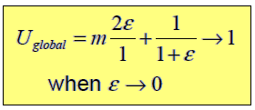
Dhall’s Effect (2 of 2)
Also applies to (greedy) RM, DM and EDF scheduling
The lowest utilization of unschedulable task sets can be arbitrarily close to 1 no matter how many processors are used.
Consequence:
New multiprocessor priority-assignment schemes are needed!

Slide 21
Another Dhall Example
Task | T | D | C | U
A | 10 | 10 | 5 | 0.5
B | 10 | 10 | 5 | 0.5
C | 12 | 12 | 8 | 0.67
On 2 processors, the Total Utilization is 1.67 < 2
If A and B run on different cores, set is not schedulable…

Slide 22
Partitioned Scheduling for Multiprocessors
One Ready Queue Per Processor
Processor₁
Processor₂
Processor₃
…
Processor_{m}

Slide 23
Partitioned Scheduling
Given a set of tasks, how to assign each task to a queue (processor)?
Notes:
Once assigned, a task only executes on the processor it is assigned to
Single-processor schedulability analysis can be carried out on each node
i.e. look at all the tasks that can be in the same ready queue
No anomalies to worry about
No Dhall’s Effect
Question:
So, how do we assign tasks?
The answer lies in the so-called Bin-Packing problem.

Slide 24
Bin-Packing
The Bin-Packing Problem
n objects, each of size ≤ 1.0, must be packed into m identical "bins", each of which is of size 1.0 such that
the sum of the objects allocated to any bin is ≤ 1.0
the number of bins used is minimized.

Slide 25
Bin-Packing Heuristics
First-Fit (FF)
Best-Fit (BF)
Next-Fit (NF)
Worst-Fit (WF)
First-Fit Decreasing (FFD)
Best-Fit Decreasing (BFD)
Worst-Fit Decreasing (WFD)
Questions to Ask:
How many bins do you need?
What is the minimum number of bins you need?
What is the maximum number of bins you need?
Can you find the optimum number of bins?

Slide 26
Next-Fit Heuristic
Fit next object into next bin that it can fit into.
If it does not fit into any bin, add a new bin to fit into.
If no object left, done. Go to Step 1.

Slide 27
Next-Fit Example
Given a list of objects of size 8, 5, 7, 6, 2, 4, 1 in that order
Pack these objects into bins of capacity 10
8
2
7
6
5
1
4

Slide 28
Best-Fit Decreasing (BFD) Heuristic
Sort the objects in descending order of size
Sort the bins in descending order of consumed space
Fit next object into first sorted bin that it can fit into
If it does not fit into any bin, add a new bin to fit into
If no object left, done. Go to Step 2.
“Tries to pack bins as much as possible with empty space in the ‘last’ bins”

Slide 29
Best-Fit Decreasing Example
Given a list of objects of size 8, 5, 7, 6, 2, 4, 1 in that order
Pack these objects into bins of capacity 10
2
4
8
1
7
6
5

Slide 30
Complexity of Bin-Packing
The bin-packing problem is known to be NP-complete:
It could take an exponential # of steps in the worst case to determine the optimal number of bins
Very efficient near-optimal heuristics exist
Best Fit Decreasing and First Fit Decreasing heuristics use no more than 11/9 OPT + 2 bins (where OPT is the number of bins given by the optimal solution).
Exception: there are simple cases which have worse performance, but can be detected and addressed as special cases.

Slide 31
The Bad Case of Bin Packing
Given a list of objects of size 0.51, 0.51, 0.51, 0.51, 0.51
Pack these objects into bins of capacity 1.0
How many bins are required?
With objects of size 0.50+e, 0.50+e, 0.50+e, 0.50+e, 0.50+e,
What is the utilization of the system?
Large objects can be a problem!
Think rocks…

Slide 32
The Good Case of Bin-Packing
Consider a list of objects of size 0.01, 0.01, 0.01, 0.01, …. (1000 objects)
Pack these objects into bins of size 1.0
How many bins are required?
Are small objects a problem?
Think sand…

Slide 33
Getting Back to Partitioned Scheduling
Only having tasks with high utilization can lead to poor utilization of processors
We refer to these tasks as “heavyweight tasks”
Only having tasks with low utilization leads to extremely good packing and high system utilization
We refer to these tasks as “lightweight tasks”
What does having a hybrid of “lighweight” and “heavyweight” tasks mean??

Slide 34
Important Points to Remember
When we perform bin-packing for partitioned scheduling, consider which scheduling policy is used
Under EDF, 100% schedulability is possible → bin-packing condition is straightforward (modulo overheads and worst-case execution time estimates).
Under RM, schedulability analysis must be carried out (exact or otherwise) → “empty space” test is less straightforward.
All tasks are assumed to be independent, i.e. there is no resource sharing
In practice, this assumption is generally not true.

Slide 35
Summary
Why multi-core embedded?
Example Architectures
Multiprocessor Scheduling
Dhall’s Effect
Global Scheduling
Partitioned Scheduling
Bin Packing
Up Next: Low-Power Embedded

